Slide 1
Unsupervised Natural Language Processing
A Textual Analysis of Selected Articles from Grantland.com
~
Greg Condit

Slide 2

What was Grantland.com?
Grantland was a long form blog owned by ESPN. Grantland was known for its award-winning writing, and it’s contributors brilliantly mixed sports, popular culture, and data analytics & visualization into riveting stories and analysis.
Grantland was writing and media as it should be, and it was shut down because it’s much harder to monetize than low-effort clickbait. This analysis is a lighthearted tribute to the site and it’s contributors.

Slide 3
Corpus & Collection
Author | Articles Scraped | Wordcount
Andrew Sharp | 10 | 14,039
Bill Barnwell | 8 | 23,783
Bill Simmons | 11 | 62,242
Brian Phillips | 10 | 17,841
Charles P. Pierce | 10 | 12,764
Jonathan Abrams | 10 | 41,791
Kirk Goldsberry | 10 | 11,974
Mark Harris | 10 | 15,744
Mark Titus | 10 | 36,736
Sean McIndoe | 10 | 20,946
Shea Serrano | 10 | 14,811
Steven Hyden | 10 | 17,857
Zach Lowe | 7 | 24,857
TOTAL | 126 | 315,385
126 Articles scraped from Grantland.com using BeautifulSoup
Contributors were chosen fairly arbitrarily by my memory of which writers I enjoyed most, which means the text will bias towards my interests, that is, mostly basketball and occasionally football.
I also added some contributors at random for variety.
The scraper pulled the most recent 10 posts for each contributor, then excluded podcast posts. Bill Simmons’s most recent posts were almost all podcasts, so his were selected manually.

Slide 4

Process Overview
Clustering using Doc2Vec
K-Means vs Spectral Clustering vs Affinity Propagation
Predicting authorship of each article
Features: Doc2vec
Features: Latent Semantic Analysis
Just for fun: Most common words per author over all selected articles
Bill Simmons was the site’s creator

Slide 5
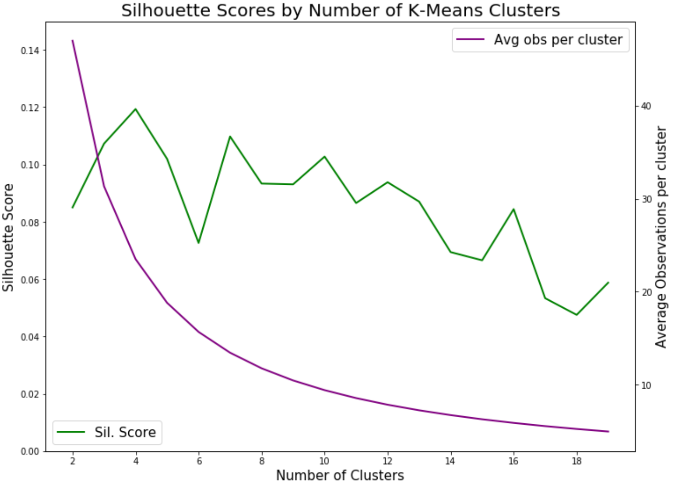
Article vectorization using Doc2vec
We’re close. Four more days and there will be professional basketball on TV every night.
Text cleaned, contractions removed
Stop words & punctuation removed, remaining words changed to lemmas
we are close. four more days and there will be professional basketball on tv every night.
['close’]
['day', 'professional', 'basketball', 'tv', 'night']
The doc2vec algorithm was used to create vector representations of 94 of the 126 articles, the rest were held out as a test set.
With the resulting vector set, silhouette scores were examined for various numbers of K-Means clusters. The highest was typically 3 or 4:

Slide 6
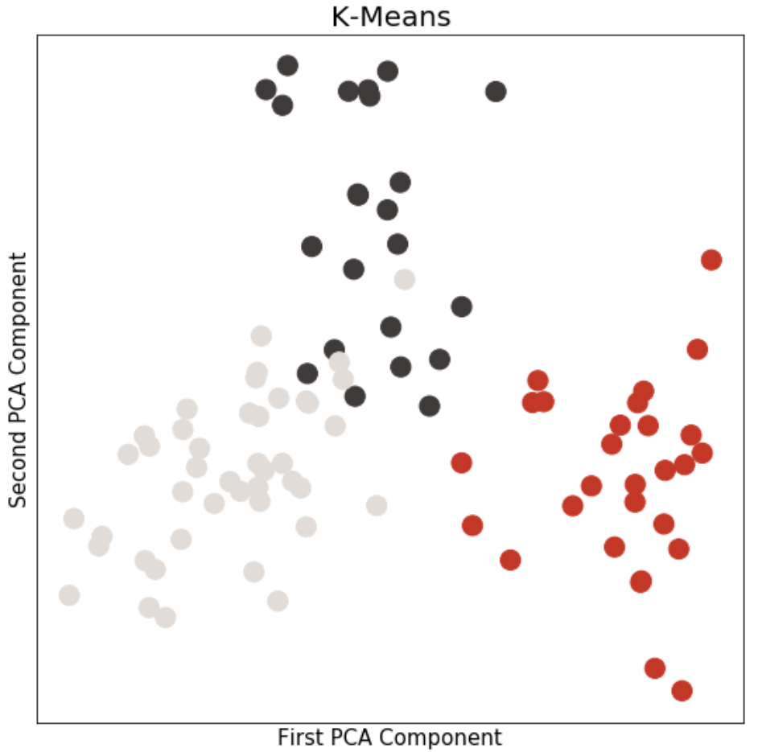
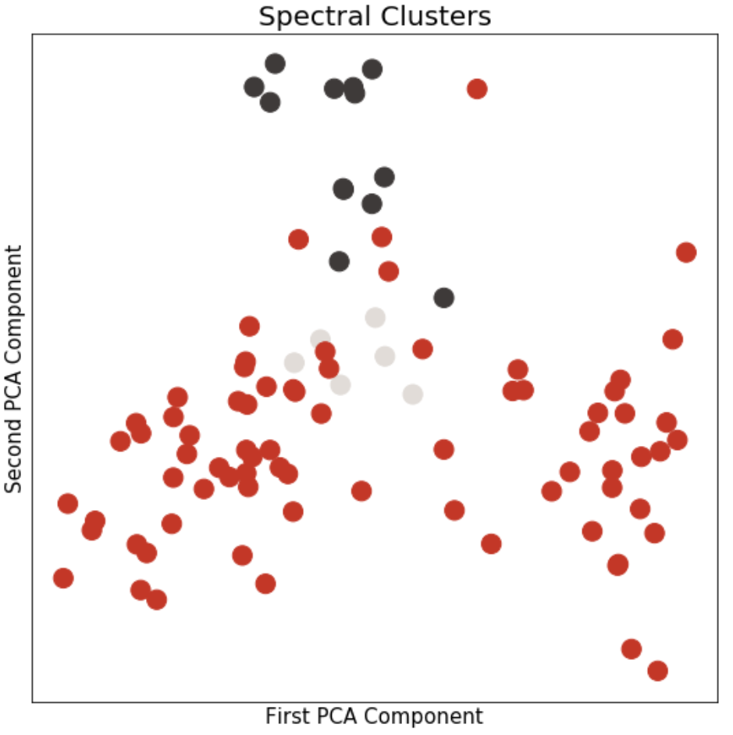
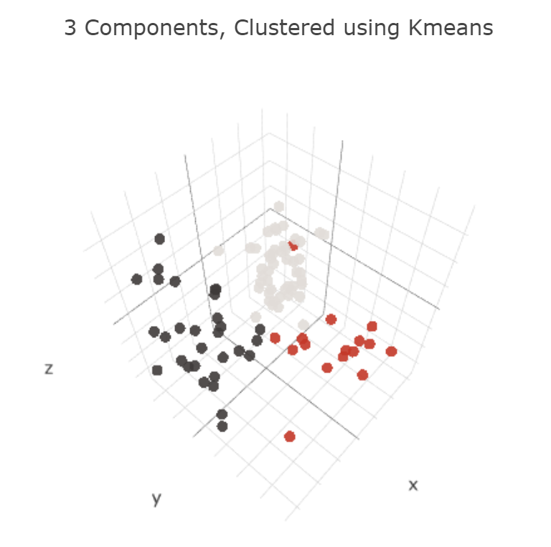
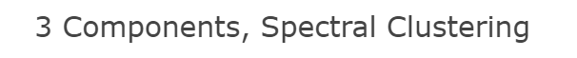
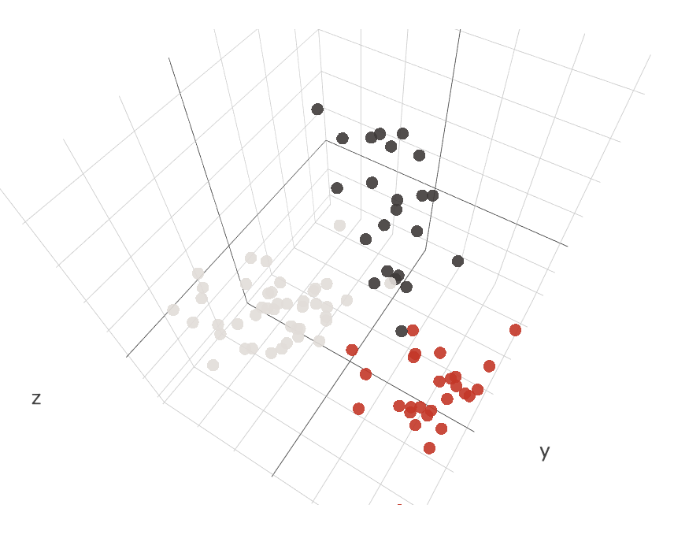
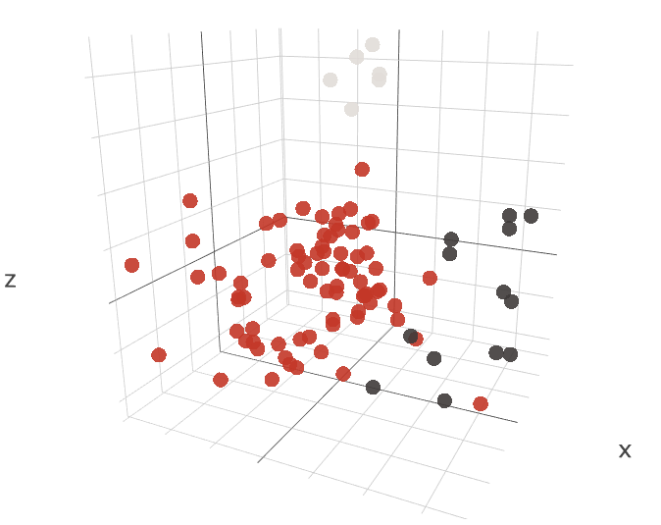
Exploration of 3-cluster methods
K-Means and Spectral Clustering were both used. The 65 dimensions created by doc2vec were reduced to 2 (or 3) dimensions for visualization using Primary Components Analysis.
K-Means created 3 clusters that are very distinct in just 2 dimensions, and almost entirely linearly separable in 3 dimensions.
Spectral is not constrained to same-size clusters, and we see that it creates 2 small clusters and one huge one, and they are not quite as easy to separate visually.
Given that these are only 2D or 3D representations of entire articles, there’s no clear-cut way to compare the two clustering methods comprehensively. K-Means has a better silhouette score (0.11) than Spectral (.04), but Silhouette scoring is mean-based, which unfairly penalizes clustering methods like Spectral that allow non-flat geometric clusters.
We also have no real “ground truth”, i.e. we don’t have 3 known classes for this data that we can compare these clusters to, so we can’t use an Adjusted Rand Index.
What remains is to assess the clusters qualitatively based on which words are most frequent in each cluster’s articles, which is done on the next page.

Slide 7
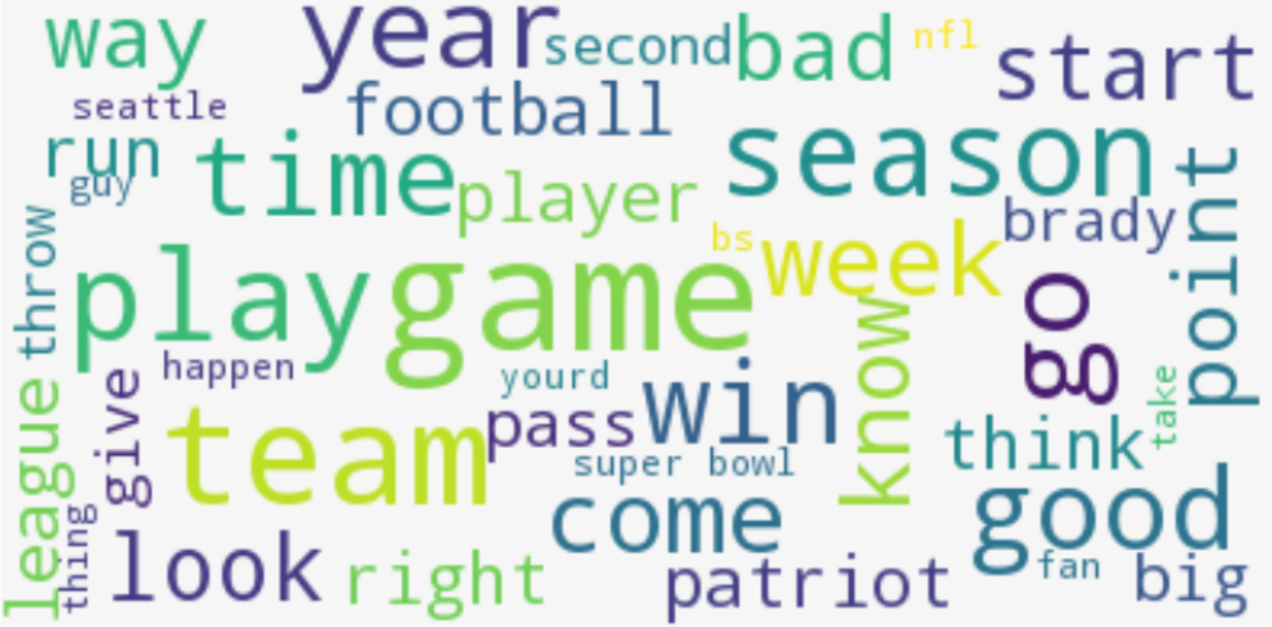
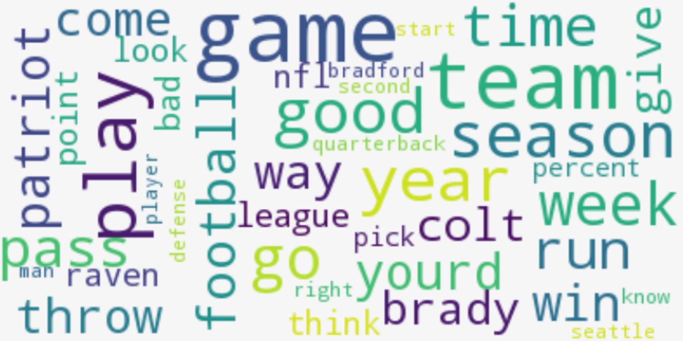
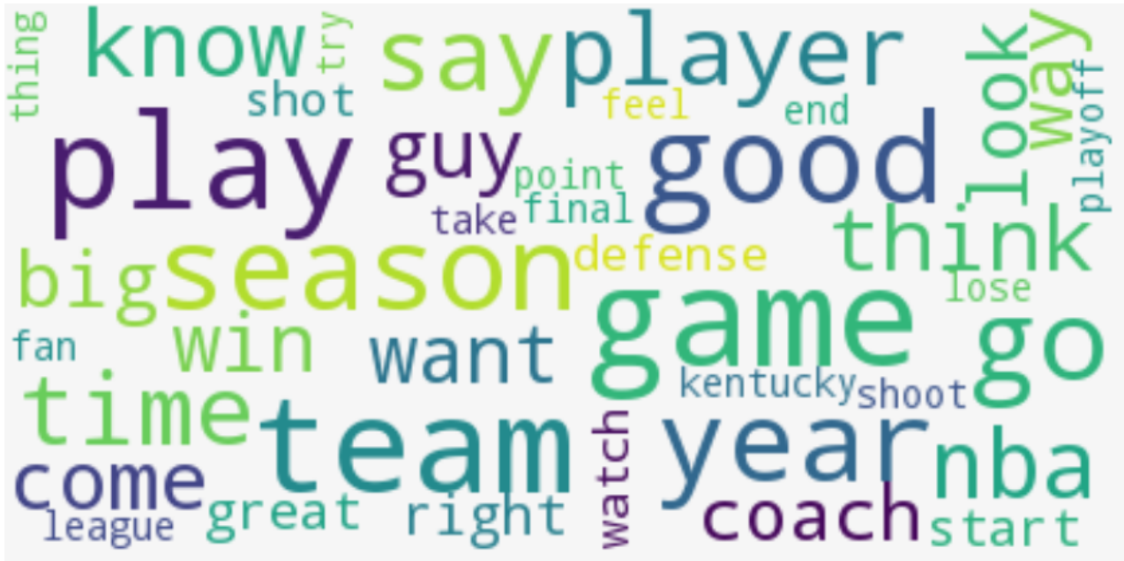
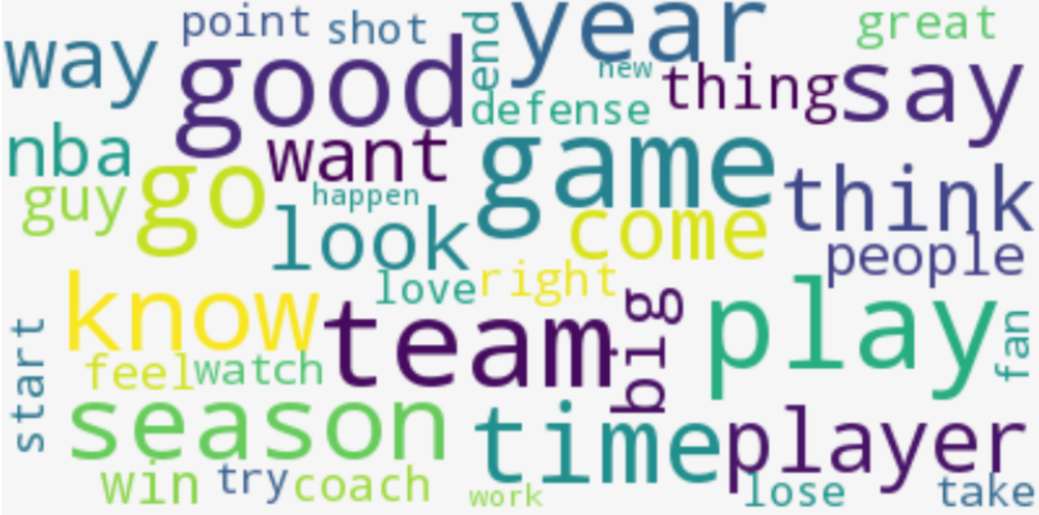
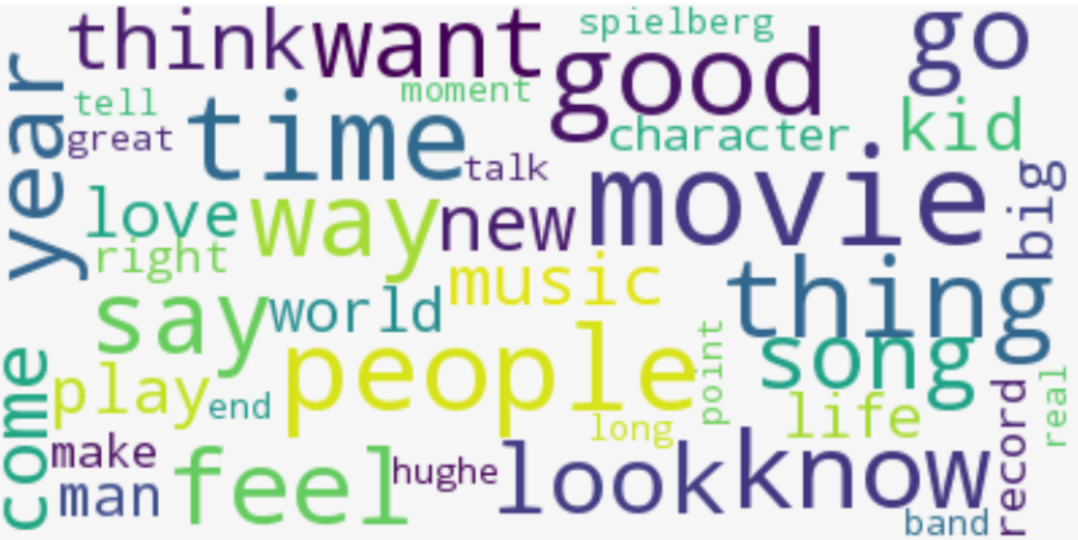
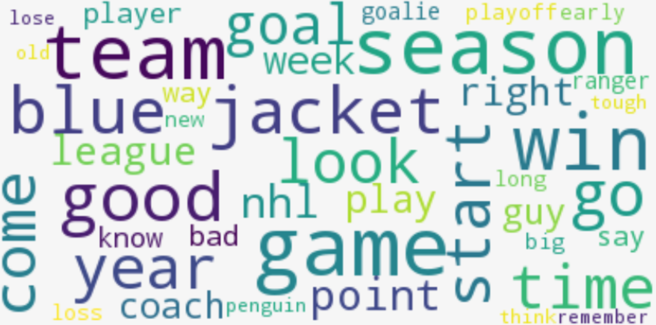
Most Common Words: 3 K-Means Clusters
Basketball and Football are what made me love Grantland, so it’s no surprise to see those consistently picked out.
The 3rd cluster is very informative. K-means assumes all clusters will be equal size, so it could never isolate a tiny minority population like the hockey articles. However, the Spectral Clustering seems to completely lose all the pop culture content that K-means captures.
This indicates that 3 was not a good choice. We need a clustering method that can decide the number of clusters for itself.
Most Common Words: 3 Spectral Clusters
Topic: Football
Topic: Football
Topic: Basketball
Topic: Basketball
Topic(s): Pop Culture/Media
Topic: Hockey

Slide 8
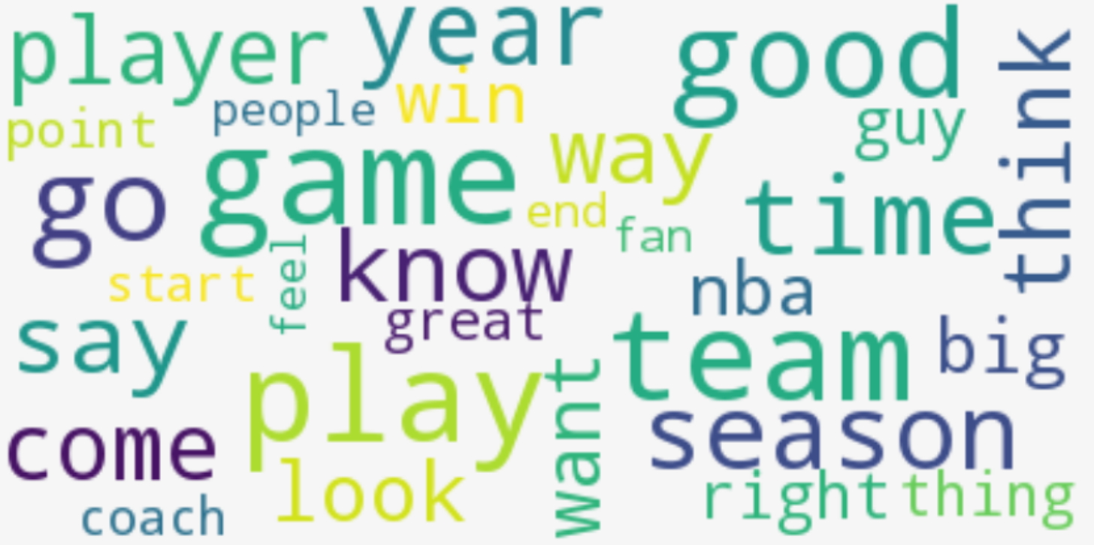
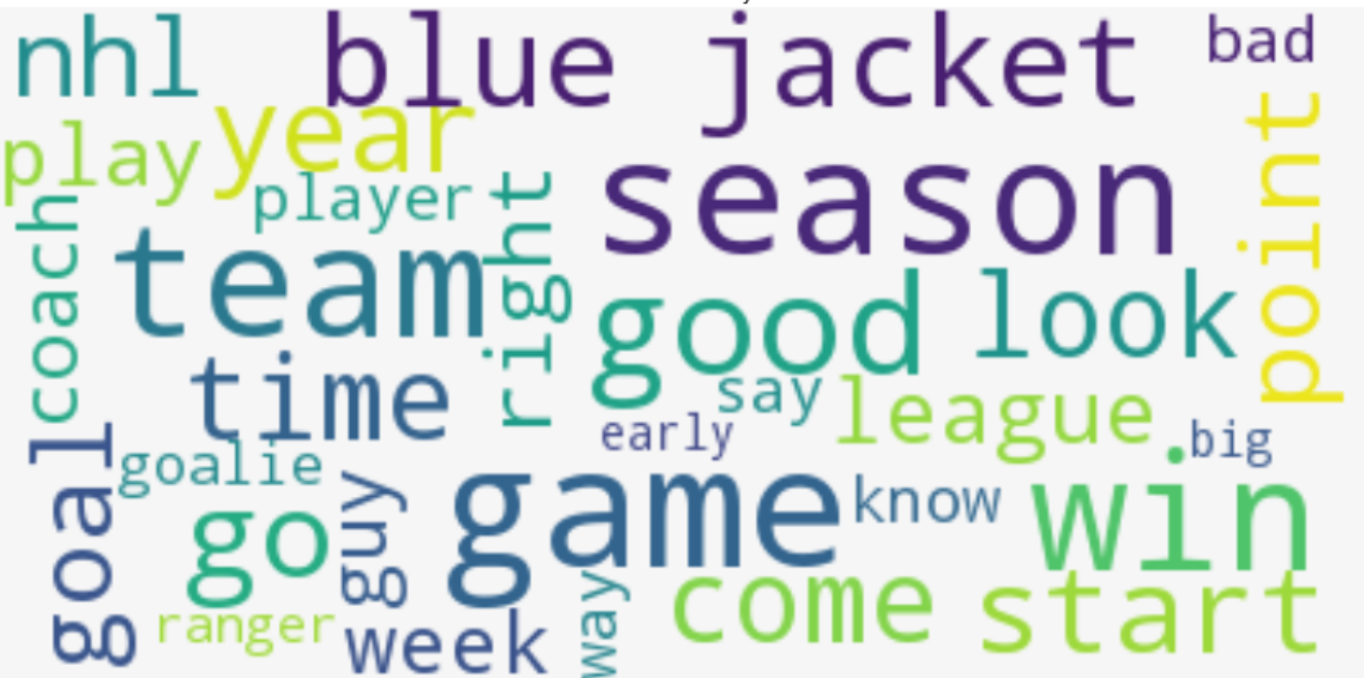
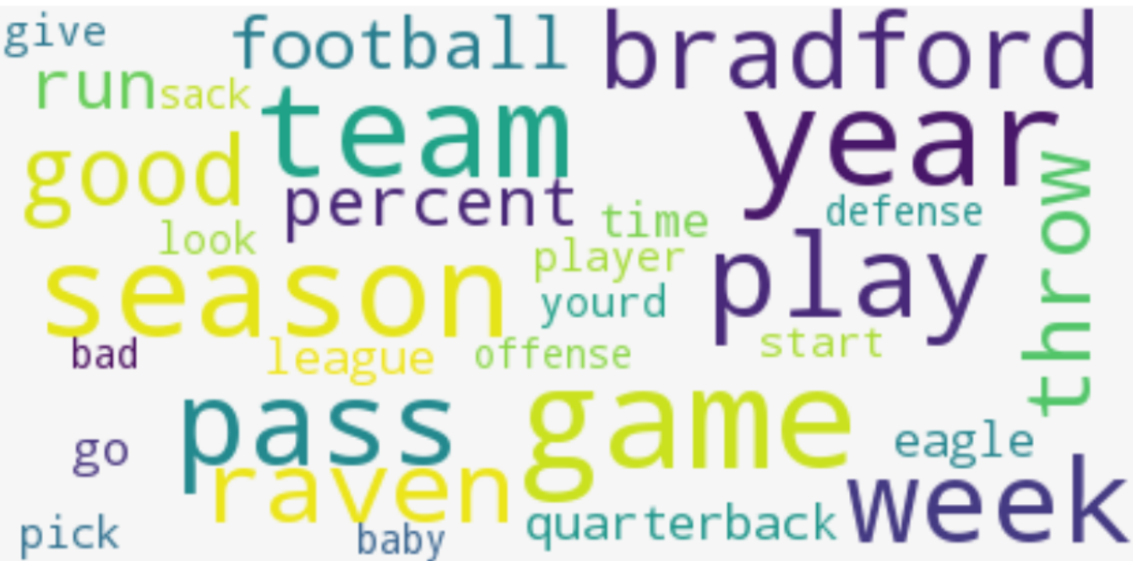
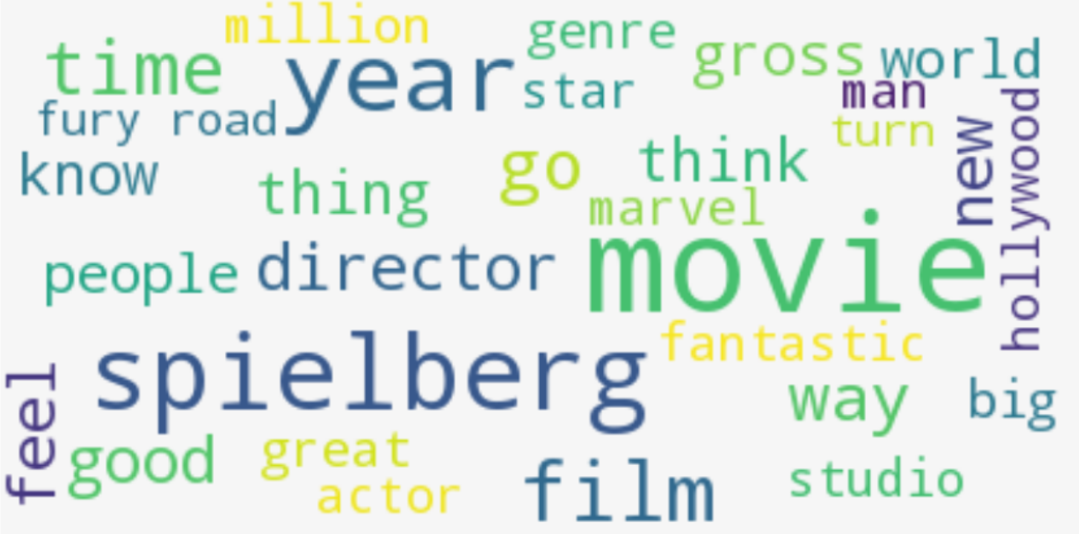
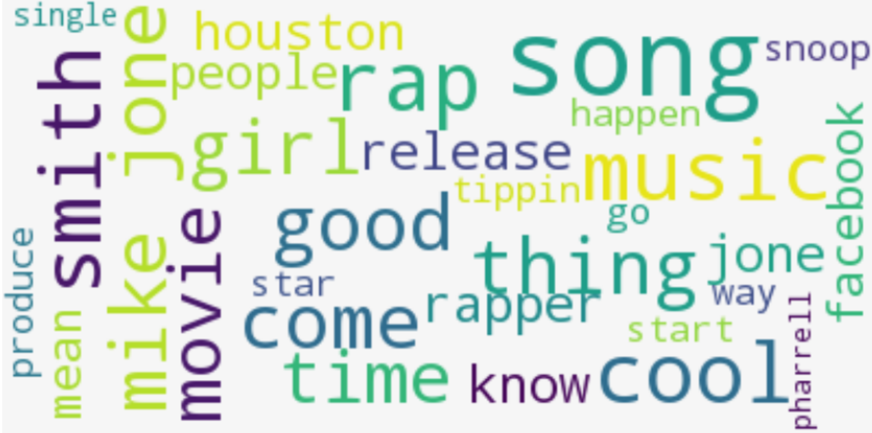
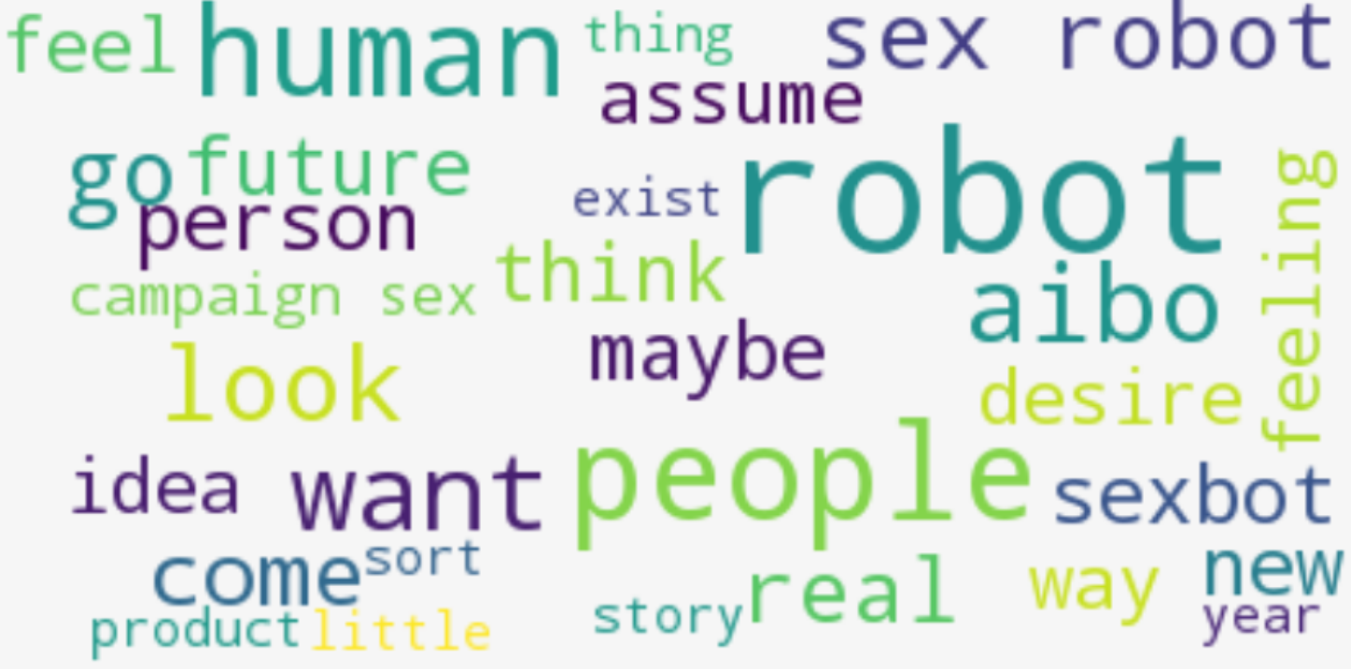
Affinity Propagation: Fitting data to a flexible # of clusters
Affinity Propagation selected 11 clusters, but upon review, 5 of them were duplicates with no topical differences. I merged those, and the below 6 are the best clustering method I found. With more data, I suspect the especially bizarre “Future” cluster would not remain consistent, it strikes me as a catch-all cluster for some irreverent outliers, whereas the other 5 are pretty defined and consistent.
Basketball
Hockey
Football
Cinema
Music
“Future”

Slide 9
Predicting authorship of each article
Random Forest, K-Nearest Neighbors, and Multi-class Logistic Regression models

